Slide 1
Nigran
Watcher, overseer, monitor

Slide 2


The Problems

Slide 3


Diffusion of Responsibility
(Faulty Handoffs)
A psychological phenomenon where individuals in a group feel less personal obligation to act in an emergency
Why we know this is a problem:
-> Consulted with an ER doctor
-> Documented Medical Case here.
-> 30–50% reduction in errors is possible with structured tools
What are its consequences:
Delays in patient’s care
Waiting hectics for the patient
Causing confusions for the patient

Slide 4

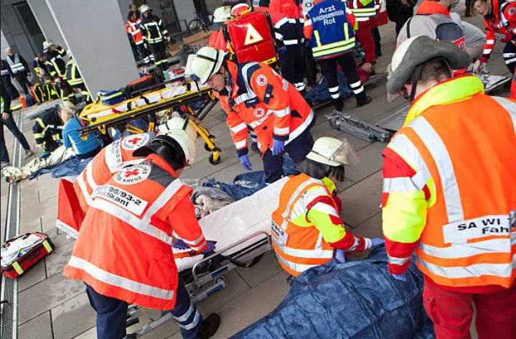
Lack of preparedness for mass casualties
hospitals lack coordinated plans, resources, and systems to rapidly manage large numbers of patients during sudden disasters or emergencies.
How we know this is a problem:
-> Ambulances Frequently Cluster at a Few Major Hospitals
-> No Real-Time Data on Hospital Capacity for First Responders
-> Delays in Critical “Golden Hour” Treatment
What are its consequences:
Precious lives are lost
Hospital resources are overused
Doctors gets overwhelmed with patients

Slide 5

The Solutions

Slide 6
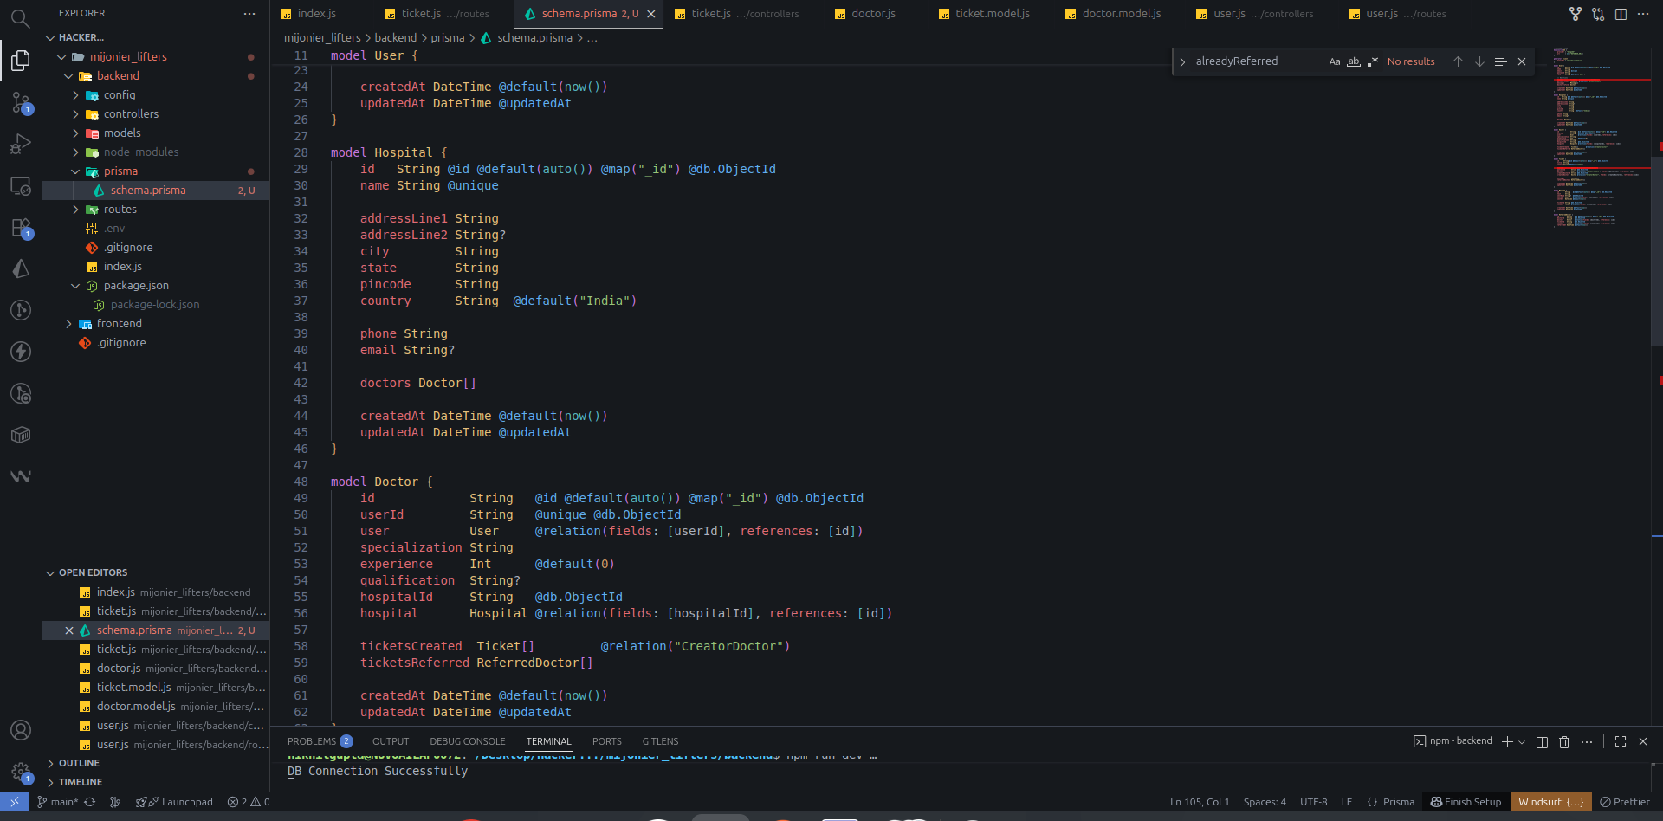
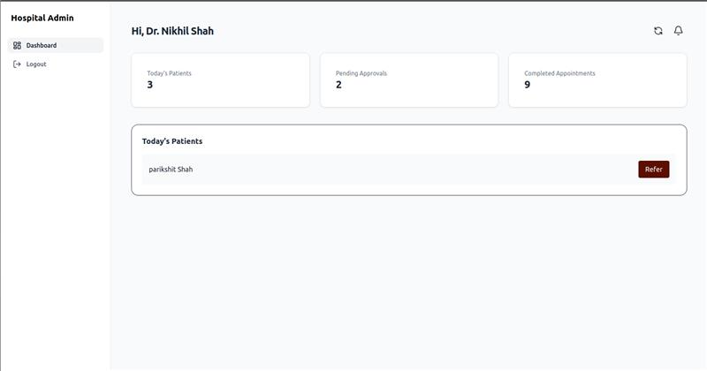
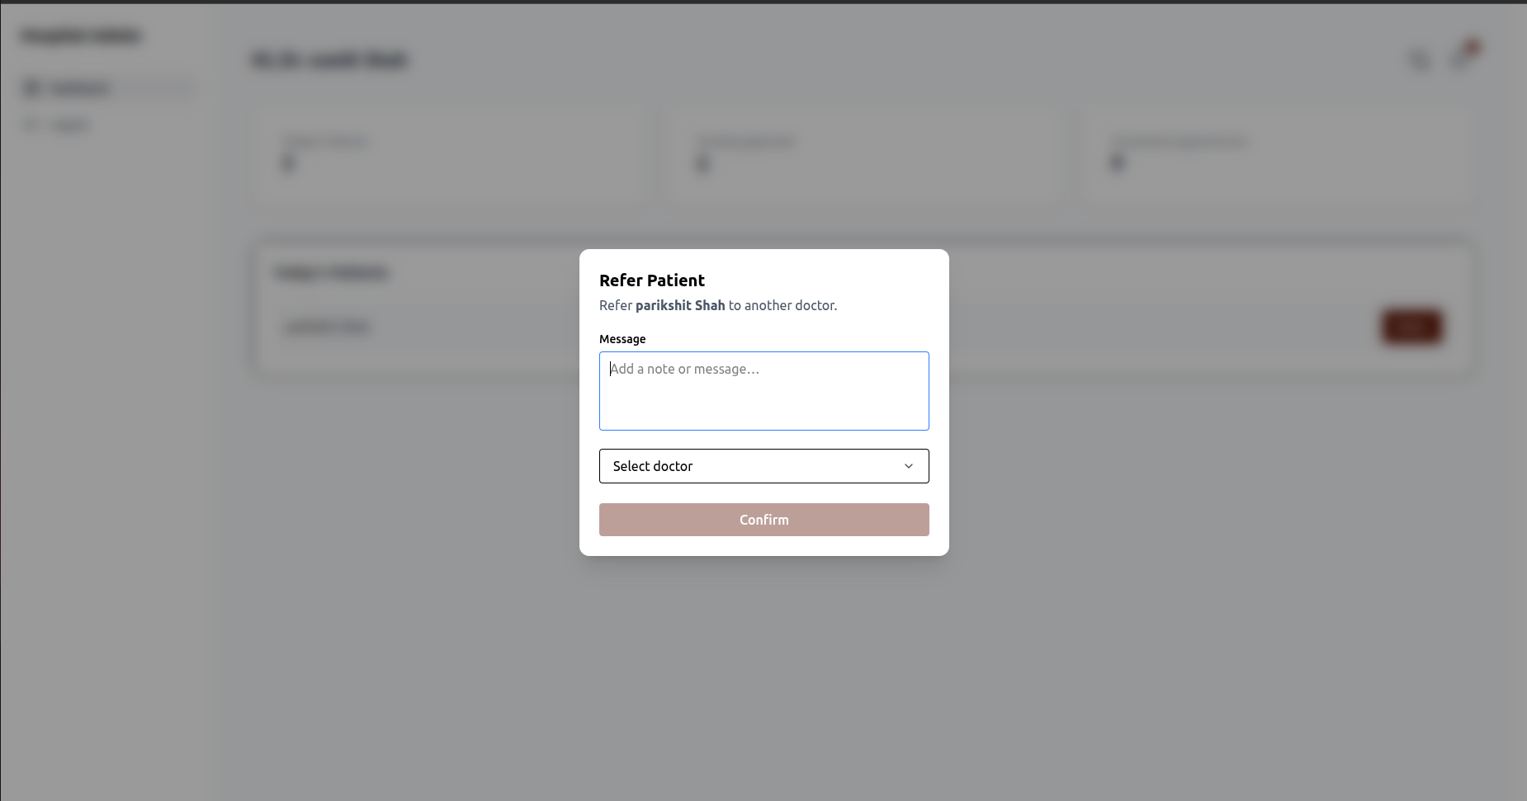
Responsibility Locking System(RSL)
Solution 1
What we propose is lets not allow doctors to keep referring once the refer comes back. Instead, Let their admin handle it further.
This will ensure that patient is treated by at least one of them as it will be made sure by the authority of their admin.

Slide 7




For Example
ER doctor (General)
Cardiologist
Go see Cardiologist
Go see ER for basic testing

Slide 8
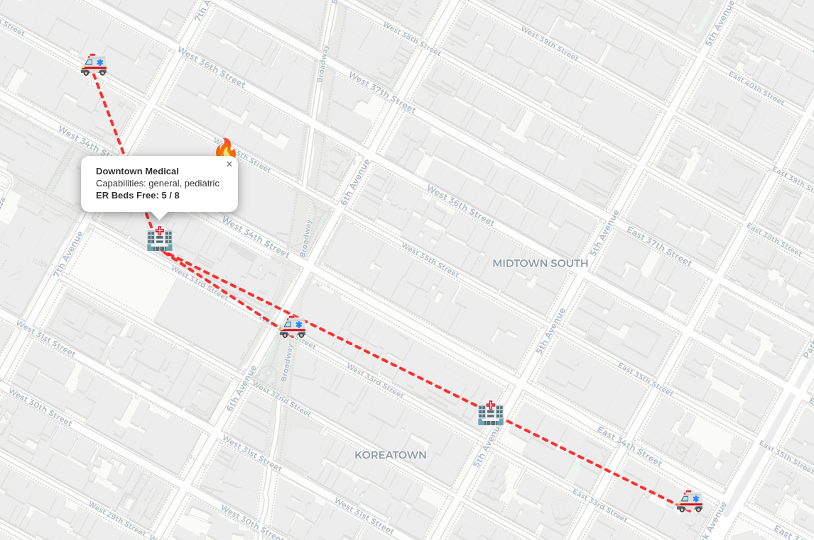
Mass-Incident Ambulance
Orchestration (MCAO)
Solution 2
What we propose is that lets add an AI layer on the first incident report and let that AI orchestrate based on resources and doctors available in the nearby hospitals to the reporter/police.
Let not the helping volunteers act on their instincts and rather help based on the suggestions given by AI.

Slide 9





For example
Injured: 16
Hospital A: 10Km
Beds Free: 5
Without Us*
With Us*
Hospital B: 8Km
16
5
4
Beds Free: 6
7
Hospital C: 16Km
Beds Free: 10

Slide 10
Impact on Medical Care in India

Slide 11

Impact
-> Reduced treatment delays through faster triage, routing, and responsible physician assignment.
-> Prevents patient bouncing between departments by locking clinical ownership early.
-> Improves survival in mass-casualty events with coordinated ambulance distribution and real-time hospital load visibility.
-> Optimizes hospital resource utilization by avoiding overcrowding at single facilities.
-> Enhances accountability & auditability across the care chain, reducing medical errors.
-> Strengthens emergency preparedness for disasters, accidents, and large public-event incidents.

Slide 12



But…
how will we stay alive and grow
… financially*

Slide 13


Go-To-Market Strategy
Differentiate using RLS + MCAO as unique high-impact innovations.
Pilot in 1–2 hospitals, then scale using case studies.
Offer RLS/MCAO as standalone modules to reduce adoption barriers.
Build partnerships with ambulance networks, EMS agencies & Smart City programs.
Use real incident-driven storytelling to highlight urgency.
Top-down government & municipal health department targeting.
Position RLS as a medico-legal protection feature for doctors.
Simple per-bed & per-ambulance pricing to boost adoption.
Monetize analytics dashboards for hospital operational insights.

Slide 14


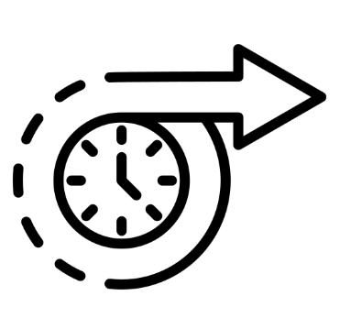
Future Scope
AI-Driven Emergency Prediction: Use machine learning to anticipate hospital overloads and auto-route ambulances before congestion occurs.
National Emergency Coordination Grid: Expand MCAO to integrate with 108/112 systems for real-time, state-wide and national mass-casualty management.
Smart Ambulance & IoT Integration: Enable live vitals streaming, automated triage, and hospital pre-alert systems for faster golden-hour response.
Automated Responsibility Workflow: Enhance RLS with AI-based doctor assignment, escalation rules, and closed-loop accountability tracking.
ABDM-Aligned Interoperability: Integrate with Ayushman Bharat Digital Mission for seamless records exchange, claim automation, and cross-hospital continuity of care.

Slide 15

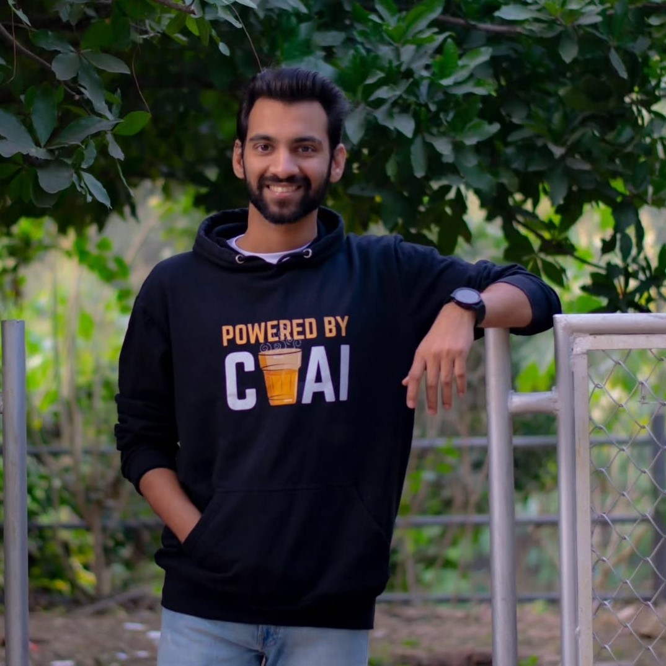
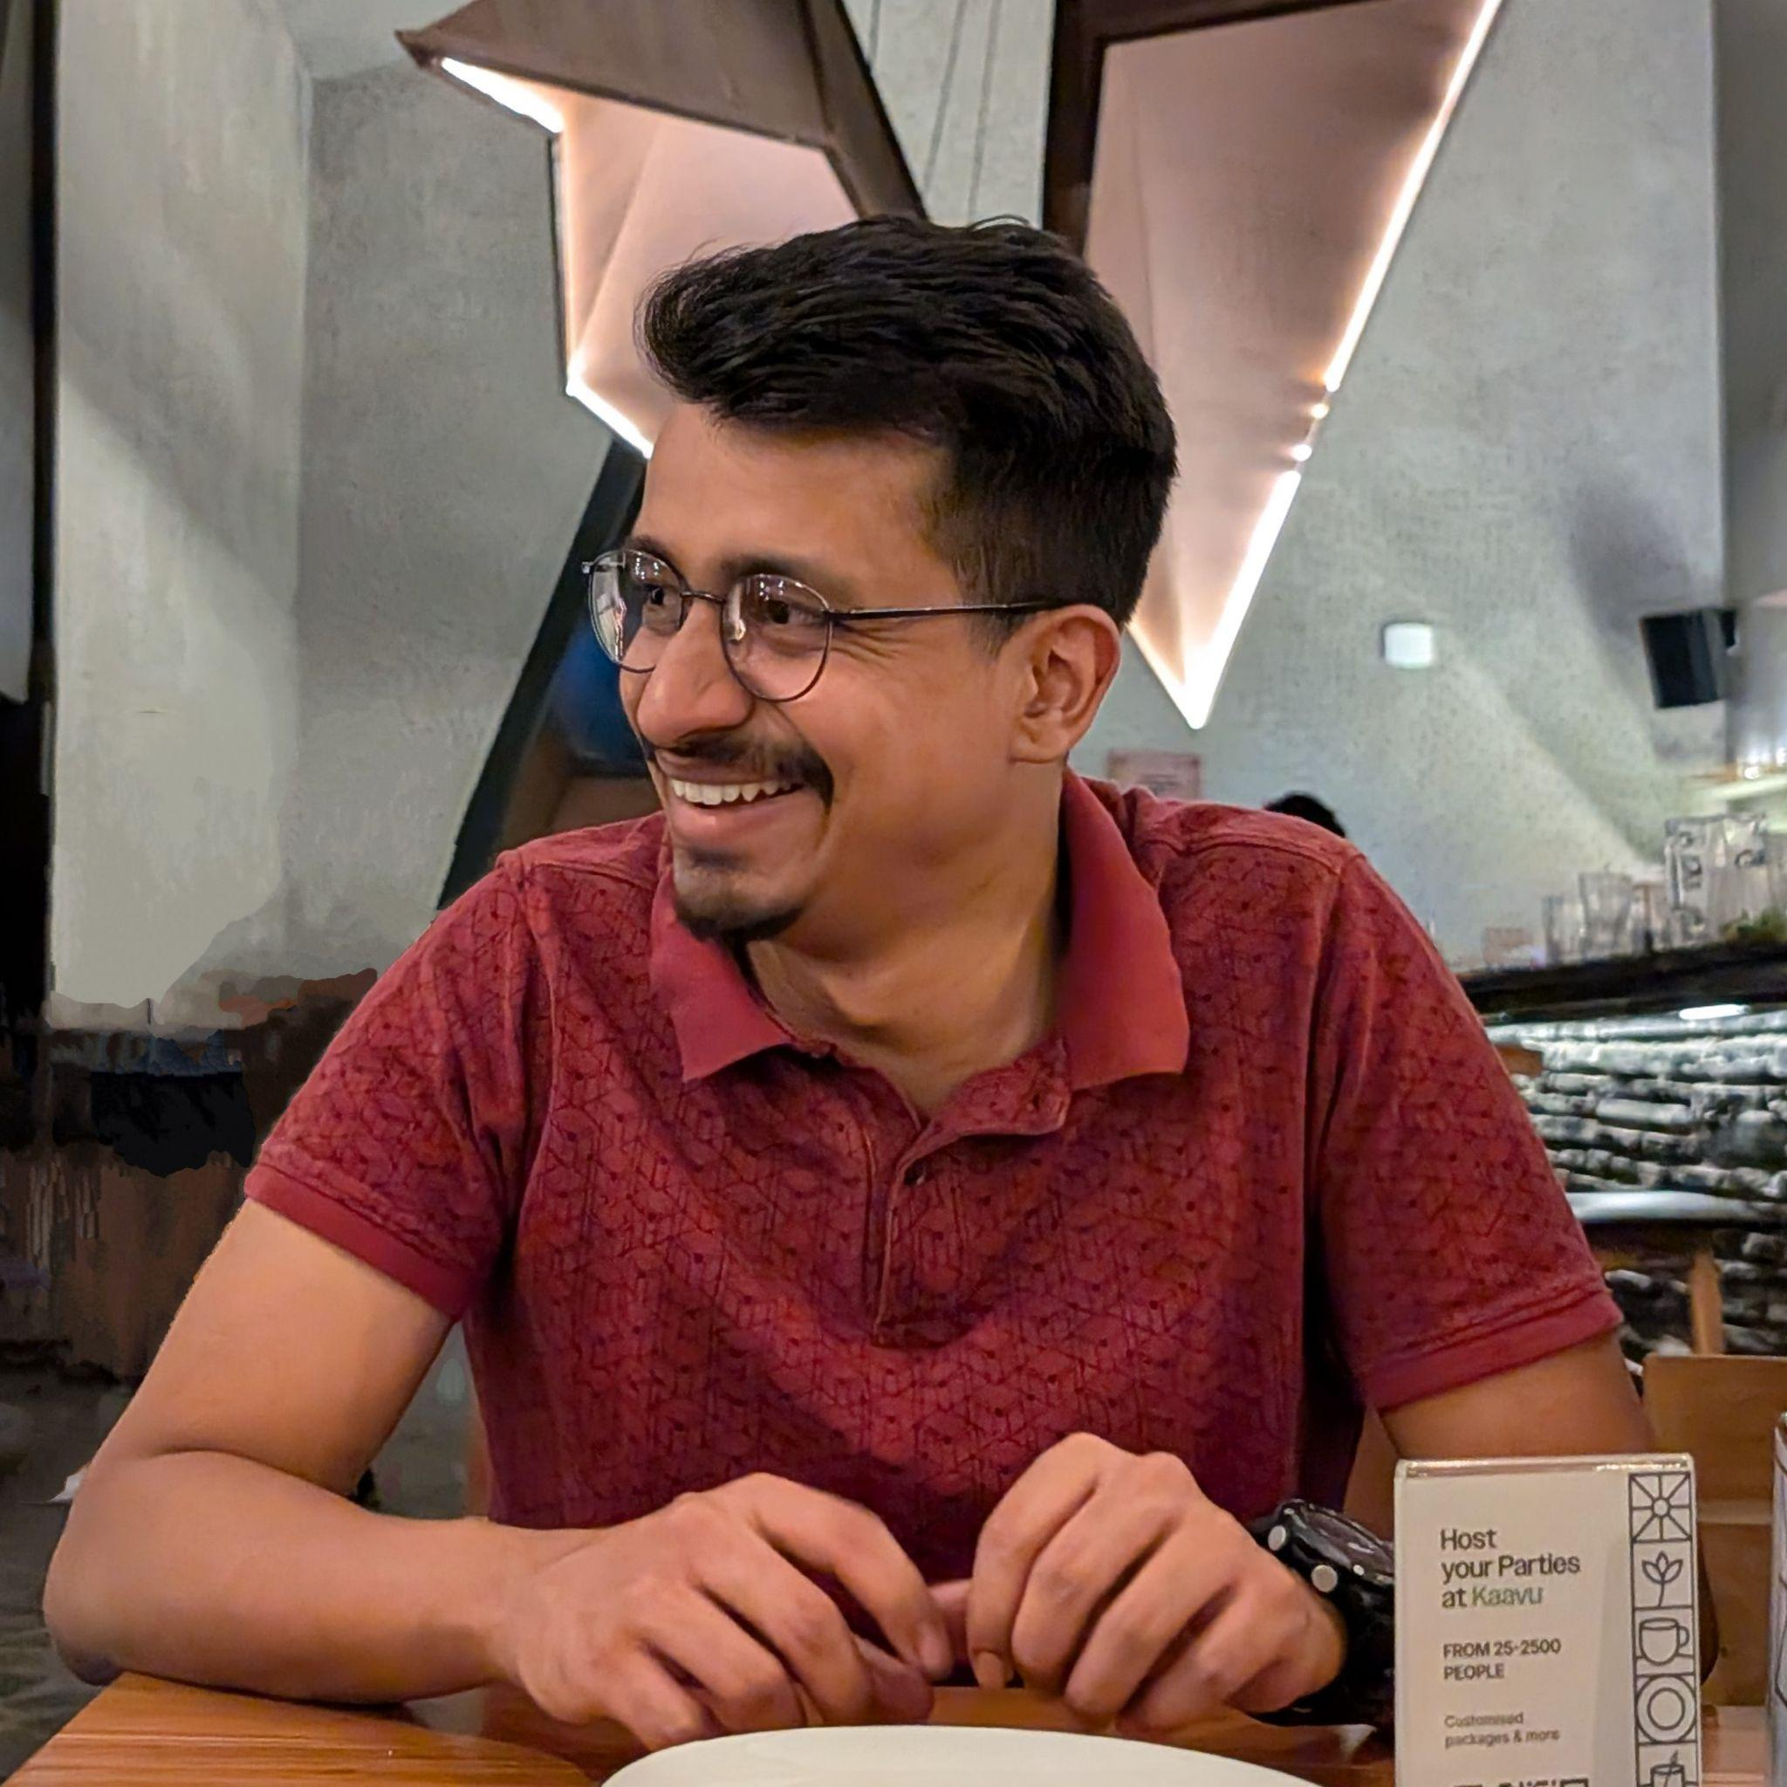


Mjolnir
Lifters
Our Team

Slide 16
Thank you

